Slide 1
Contents
Problem Definition
Scope and Objectives
Literature Review
System Diagram
Experimental Setup (if required)
Performance Parameters
Efficiency Issues
Tools and Techniques used
Testing
Results
Team Work(roles of members)
IPR/Patent/Publication/participation
Conclusion and Future Work
Project link: https://github.com/akshat-patil/Projects-

Slide 2
Problem Definition
In machine learning, preparing the data for analysis is a crucial step, but it can be very time-consuming and prone to mistakes. Developers often need to clean the data by handling missing values, scaling numbers, encoding categories, and removing unnecessary information. Doing this manually can slow down the entire process and lead to errors.

Slide 3
Scope
It is assumed that the uploaded CSV files follow a standard format where each row represents a data instance and each column represents a feature.
The tool assumes that the dataset provided is reasonably clean, with no extreme errors or outliers that would prevent basic preprocessing tasks from being performed.
The tool assumes that users will have some understanding of their data or will at least be able to guide the tool on certain parameters
The tool assumes that the dataset mainly consists of common data types

Slide 4
Objectives
To develop an intelligent tool that automatically detects and classifies different column types in numerical datasets
To implement automatic handling of missing values by using appropriate techniques such as imputation or removal based on the data type and context.
To normalize and scale numerical data to ensure that all features are in a consistent range for machine learning models.
To automatically encode categorical variables into numerical formats, making them compatible with machine learning algorithms that require numerical input.

Slide 5
Literature Survey
Sr. | Paper Name | Description | Published | Year
1 | Implementation of Machine Learning Based on Google’s Teachable Machine and Waterfall Method to Detect Shoulder Surfing Attack | This paper explores the implementation of a machine learning model using Google’s Teachable Machine framework to detect shoulder surfing attacks in real-time. | IEEE International Conference on Artificial Intelligence and Mechatronics Systems (AIMS) | 2024
2 | Learning Rate Optimization for Enhanced Hand Gesture Recognition using Google Teachable Machine | This paper presents a study on optimizing learning rates to improve the performance of hand gesture recognition systems using Google’s Teachable Machine. It discusses various learning rate strategies and their impact on model accuracy and training efficiency | IEEE 13th International Conference on Control System, Computing and Engineering (ICCSCE) | 2023

Slide 6
Sr. | Paper Name | Description | Published | Year
3 | Neural Network Training Method Based on Dynamic Segmentation of the Training Dataset | In this paper, the authors introduce a novel neural network training method that utilizes dynamic segmentation of the training dataset to enhance model performance. This approach aims to adaptively modify the training data’s structure based on learning progress, facilitating more efficient convergence and reduced over fitting. | 39th Youth Academic Annual Conference of Chinese Association of Automation (YAC) | 2024
4 | Tensor Train Decomposition for Efficient Spiking Neural Network Training | This paper investigates the application of tensor train decomposition techniques to optimize the training of spiking neural networks (SNNs). By leveraging tensor decomposition, the study aims to reduce computational complexity while maintaining high accuracy in learning temporal patterns | Design, Automation & Test in Europe Conference & Exhibition | 2024

Slide 7
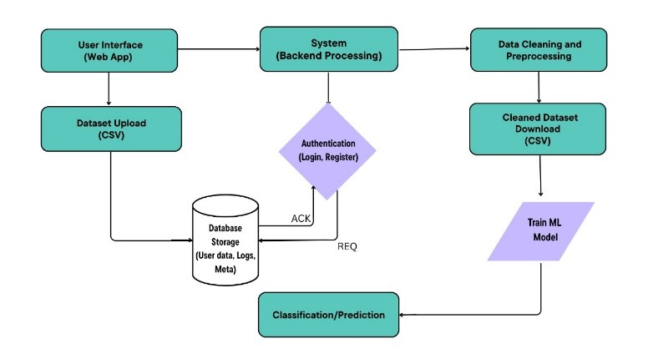
System Architecture Diagram

Slide 8
Experimental Setup
HARDWARE REQUIREMENTS
1. Processor - Pentium IV/Intel I3 core
2. Speed - 1.1 GHZ
3. RAM - 512 MB(min)
4. Hard disk - 20 GB
5. Keyboard - Standard Keyboard
6. Mouse - Two Or Three Button Mouse
7. Monitor - LED Monitor

Slide 9
Software Requirements
1. Operating System : Windows xp/7/8/10
2. Software Version : Python 3.10
3. Tools : VSCode
4. Front End : Django

Slide 10
Performance Parameters
Measures how correctly the tool identifies whether a column is continuous, categorical, or binary. Higher accuracy means better and more appropriate preprocessing steps are applied.
Checks how quickly the tool completes all preprocessing tasks (like handling missing values, encoding, scaling) after the CSV file is uploaded. Faster speed improves user experience, especially with large datasets.
Evaluates how well the tool identifies and fills or removes missing values without losing important information or harming the quality of the dataset.
Assesses whether the final, processed dataset is clean, free from errors, and ready for machine learning model building with minimal manual corrections needed.

Slide 11
Efficiency
The tool might slow down or even crash when dealing with very large datasets if enough memory or processing power isn’t available.
In some tricky cases, the tool might wrongly classify column types (e.g., treating a categorical column as continuous), leading to wrong preprocessing steps.
The tool might not always choose the best missing value strategy (like mean filling when mode or median would have been better), affecting the dataset quality.
During normalization, encoding, and scaling, the tool may use a lot of CPU and RAM, making it less efficient for users with low-end systems.

Slide 12
Tools And Technology
Python is a high-level, interpreted programming language celebrated for its clear and straightforward syntax.
Django : Django is a high-level Python web framework designed to facilitate rapid development and promote clean, practical design
Vs code Used for Coding

Slide 13
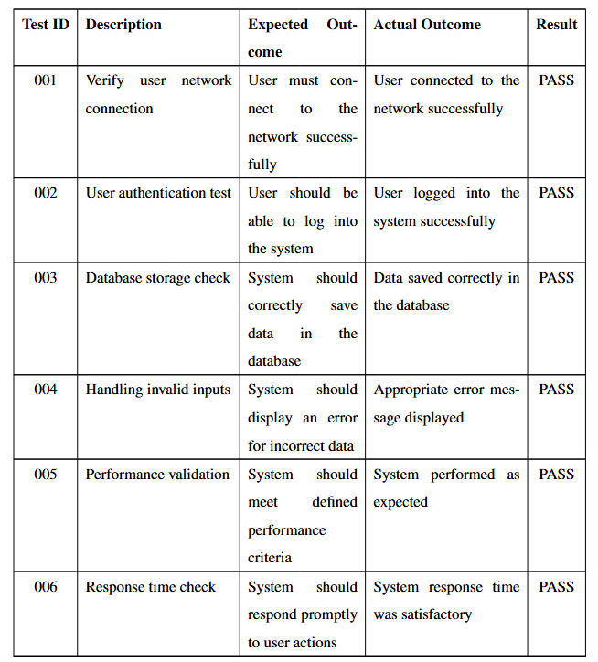
Testing

Slide 14

Results

Slide 15
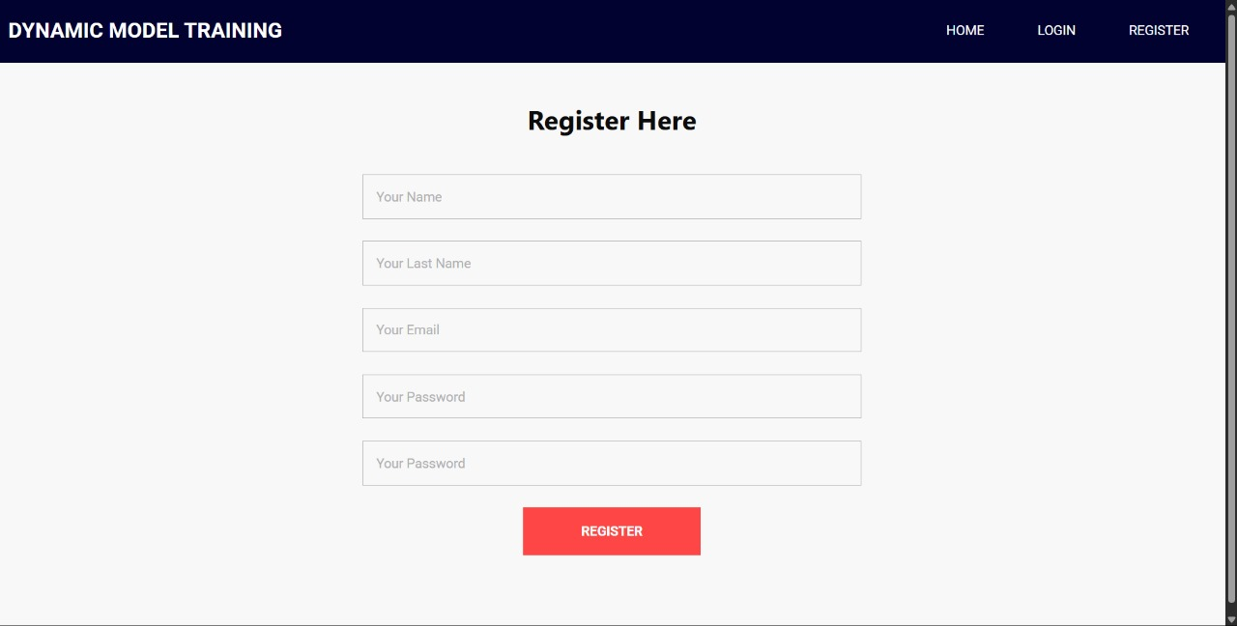
Results

Slide 16
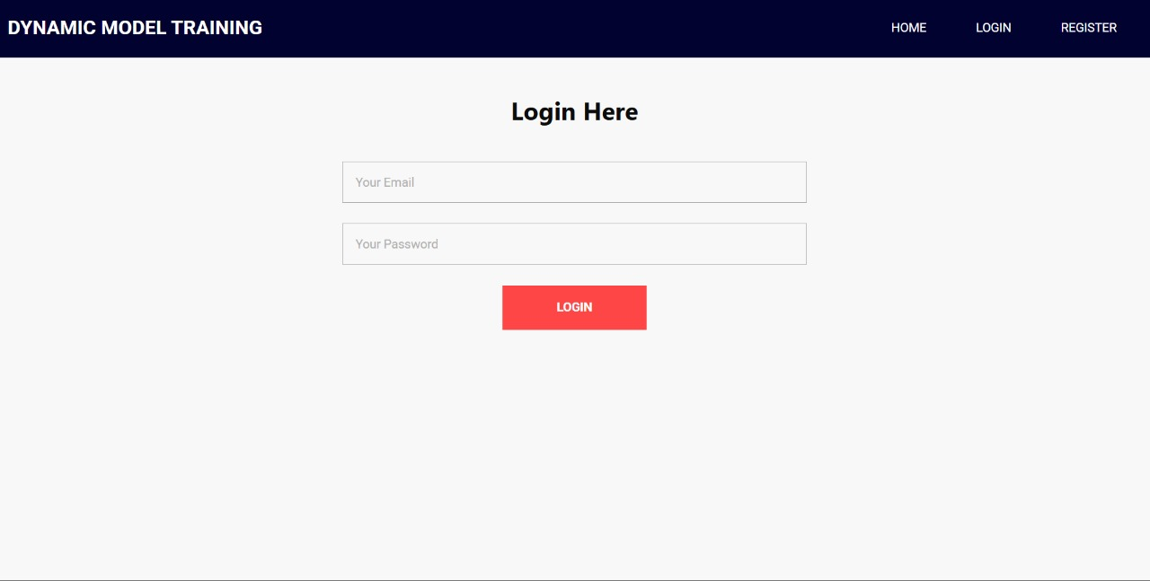
Results

Slide 17
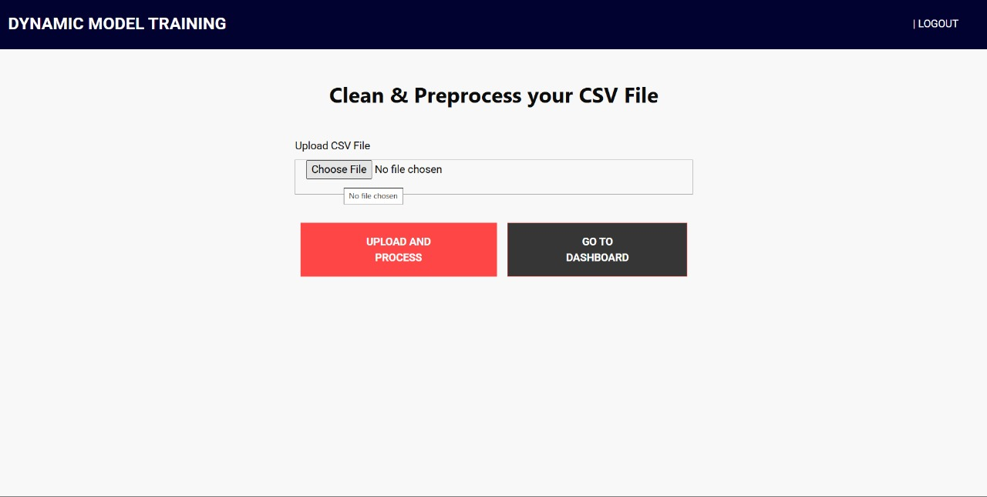
Results

Slide 18
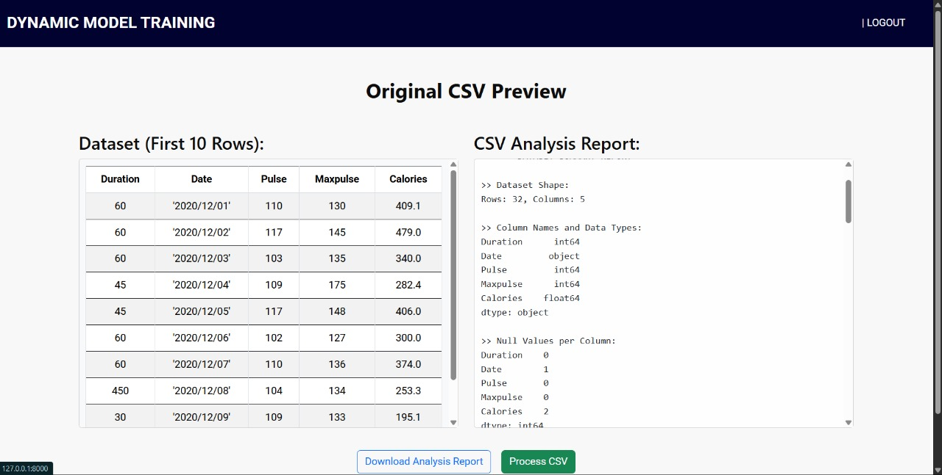
Results

Slide 19
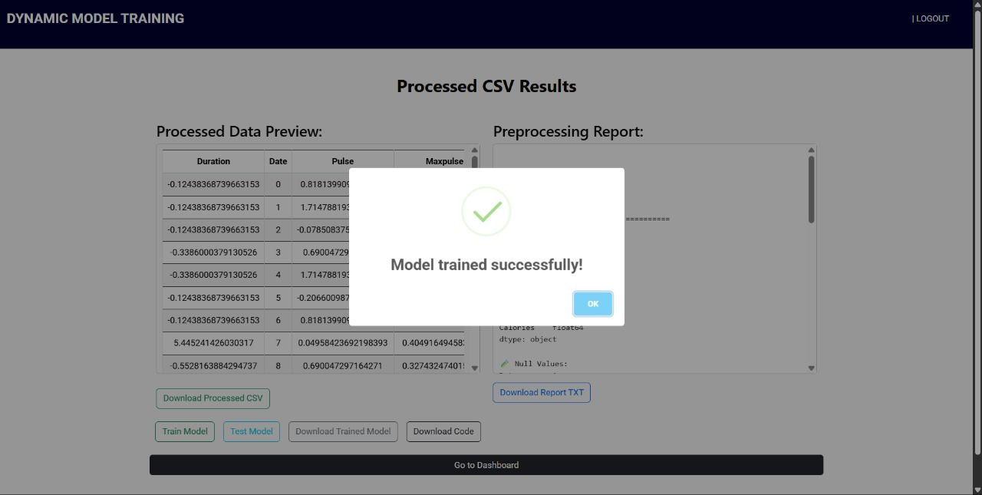
Results

Slide 20
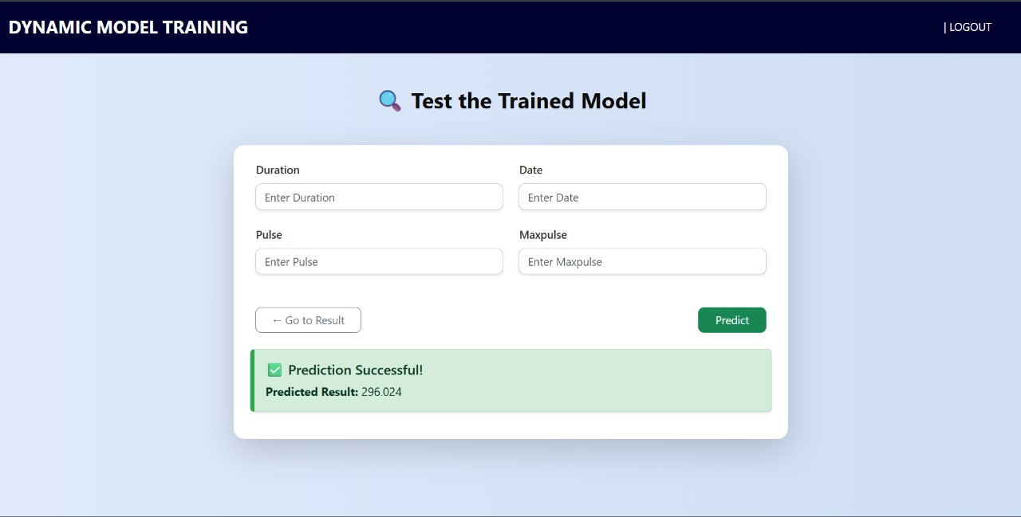
Results

Slide 21
Paper Publication Details
We have Published our paper in IJIRMPS
Impact factor : 9.907
ISSN : 2349 -7300

Slide 22
Conclusion
This project provides a simple and smart tool that helps machine learning developers by automatically cleaning and preparing their datasets. By handling important tasks like missing values, scaling numbers, encoding categories, and removing duplicates, the tool saves users a lot of time and effort. It also reduces the chances of mistakes that can happen when preprocessing is done manually.

Slide 23
Future Scope
In the future, the tool can be improved by supporting more file types like Excel or JSON, not just CSV. Advanced techniques like automatic feature selection, data balancing (for imbalanced datasets), and smarter missing value handling can be added. We can also build a web-based version so users can preprocess their data online without installing anything. Adding real-time suggestions and detailed reports about the data quality and processing steps would make it even more helpful for users.

Slide 24
THANK YOU !!

